Slide 1


Intake/Interview & Quality Review Sheet
IRS Form 13614-C

Slide 2
IRS Intake/Interview Sheet –
Form 13614-C
Must be completed for every tax return we prepare
Required starting point for taxpayer(s) is to complete Form 13614-C
The Intake/Interview sheet is the basis for the taxpayer interview
The Intake/Interview Sheet is to be corrected as required from taxpayer documents and the interview
Taxpayer fills out most, but volunteers may assist

Slide 3
Obtain a copy of 13614-C
Link to Form
Form 13614-C (Rev. 10-2019) (irs.gov)

Slide 4
Intake/Interview & Quality Review Sheet (13614-C) - Page 1
General information about taxpayer, spouse and dependents.
  Completed by taxpayer except for Part II shaded area
  Information on this page entered IN “Basic Information” section TaxSlayer by preparer
  Part I - Taxpayer personal information
  Part II - Marital Status & Household information
  Part II shaded area – to be completed by preparer
Notes:
Post a copy of the Intake Form on the web site so that students can print it or look at it full screen.

Slide 5
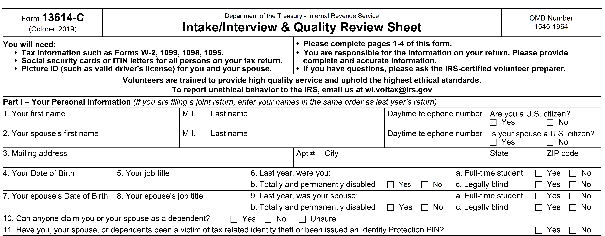
Intake Sheet Page 1
Personal Information Part I

Slide 6
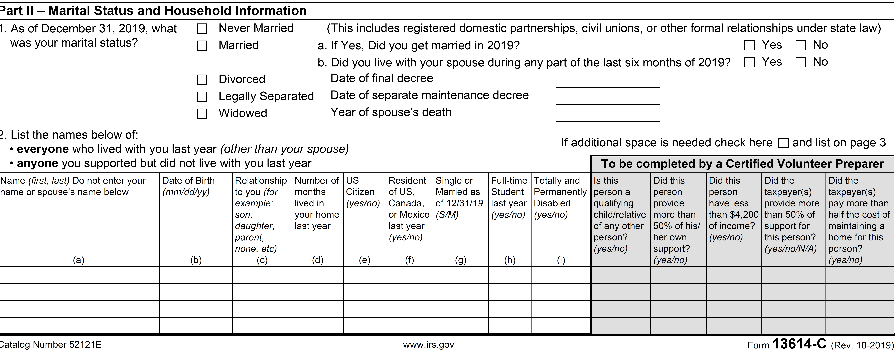
Intake Sheet Page 1
Marital & Household Information – Part II

Slide 7
Intake/Interview & Quality Review Sheet (13614-C) - Page 2
Part III – Income questions
Part IV – Expense questions
Part V – Life events questions
Answers to all the questions must agree with documents presented by taxpayer
Preparer to make corrections and initial where changes are made

Slide 8
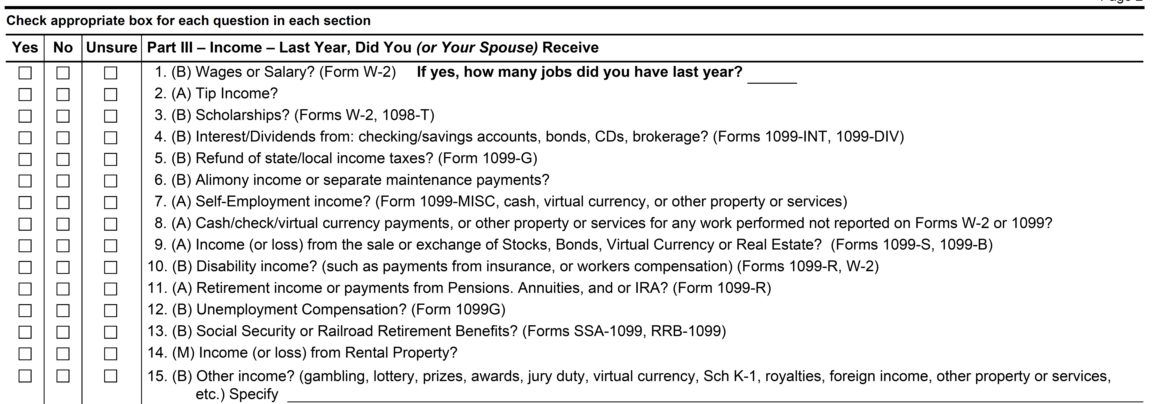
Intake Sheet Page 2
Income – Part III

Slide 9
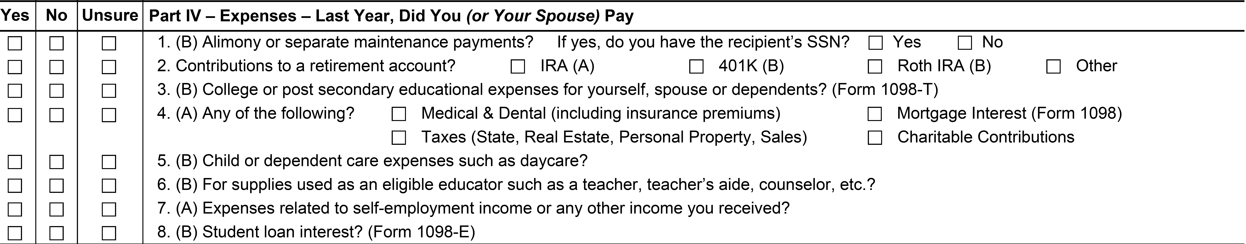
Intake Sheet Page 2
Expenses – Part IV

Slide 10
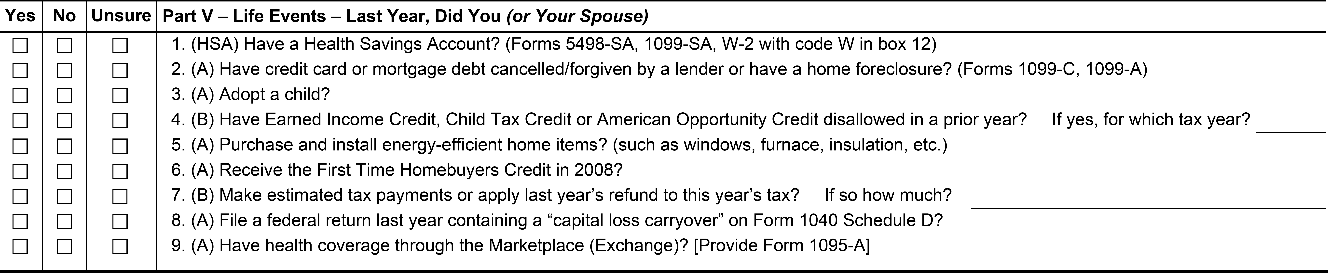
Intake Sheet Page 2
Life Events – Part V

Slide 11
Intake/Interview & Quality Review Sheet (13614-C) Page 3
Additional Information & Questions
Taxpayer email address (not required)
Presidential Election Campaign Fund question
Tax refund questions
Balance due questions
Grant Money Questions
Additional comments

Slide 12
Intake Sheet Page 3 – Additional Information & Questions

Slide 13
AARP Intake Book –Additional Data
Additional optional statistical questions
  Additional Statistical Questions
  Instructions on how to use the Intake Booklet
    Brief description of three consent forms
  Three consent forms

Slide 14
AARP Intake Booklet Optional Questions

Slide 15
AARP Intake Book –How to Use

Slide 16
AARP Intake Book-Consent Form 1

Slide 17
Summary
The Intake/ Interview & Quality Review Sheet is required for every tax return we prepare
The Intake Sheet is completed by the taxpayer and reviewed and corrected by the preparer prior to entering any information into TaxSlayer Software.
The Intake Sheet is kept by the taxpayer

Slide 18

Questions

